Slide 1
BLM2502 Theory of Computation

Slide 2
BLM2502 Theory of Computation
Course Outline
Week Content
1 Introduction to Course
2 Computability Theory, Complexity Theory, Automata Theory, Set Theory, Relations, Proofs, Pigeonhole Principle
3 Regular Expressions
4 Finite Automata
5 Deterministic and Nondeterministic Finite Automata
6 Epsilon Transition, Equivalence of Automata
7 Pumping Theorem
8 April 10 - 14 week is the first midterm week
9 Context Free Grammars
10 Parse Tree, Ambiguity,
11 Pumping Theorem
12 Turing Machines, Recognition and Computation, Church-Turing Hypothesis
13 Turing Machines, Recognition and Computation, Church-Turing Hypothesis
14 May 22 – 27 week is the second midterm week
15 Review
16 Final Exam date will be announced

Slide 3
Non-regular languages
(Pumping Lemma)

Slide 4
Non-regular languages
Regular languages

Slide 5
How can we prove that a language
is not regular?
Prove that there is no DFA or NFA or RE
that accepts
Difficulty: this is not easy to prove
(since there is an infinite number of them)
Solution: use the Pumping Lemma !!!

Slide 6

The Pigeonhole Principle

Slide 7
pigeons
pigeonholes

Slide 8
A pigeonhole must
contain at least two pigeons

Slide 9
pigeons
...........
pigeonholes
...........

Slide 10
The Pigeonhole Principle
pigeons
pigeonholes
There is a pigeonhole
with at least 2 pigeons
...........

Slide 11
The Pigeonhole Principle and DFAs

Slide 12
Consider a DFA with states

Slide 13
Consider the walk of a “long’’ string:
(length at least 4)
A state is repeated in the walk of

Slide 14
The state is repeated as a result of
the pigeonhole principle
Walk of
Pigeons:
(walk states)
Are more than
Nests:
(Automaton states)
Repeated
state

Slide 15
Consider the walk of a “long’’ string:
(length at least 4)
Due to the pigeonhole principle:
A state is repeated in the walk of

Slide 16
The state is repeated as a result of
the pigeonhole principle
Walk of
Pigeons:
(walk states)
Are more than
Nests:
(Automaton states)
Automaton States
Repeated
state

Slide 17
In General:
If ,
by the pigeonhole principle,
a state is repeated in the walk
Walk of
....
....
....
Arbitrary DFA
......
......
Repeated state

Slide 18
Walk of
Pigeons:
(walk states)
....
....
....
Are
more
than
....
....
Nests:
(Automaton states)
A state is
repeated

Slide 19
The Pumping Lemma

Slide 20
Take an infinite regular language
(contains an infinite number of strings)
There exists a DFA that accepts
states

Slide 21
Take string with
(number of
states of DFA)
then, at least one state is repeated
in the walk of
Walk in DFA of
......
......
Repeated state in DFA

Slide 22
There could be many states repeated
Take to be the first state repeated
One dimensional projection of walk :
First
occurrence
Second
occurrence
....
....
....
Unique states

Slide 23
We can write
One dimensional projection of walk :
First
occurrence
Second
occurrence
....
....
....

Slide 24
In DFA:
contains only
first occurrence of
...
...
...
...

Slide 25
Observation:
length
number
of states
of DFA
...
Unique States
...
Since, in no
state is repeated
(except q)

Slide 26
Observation:
length
Since there is at least one transition in loop
...

Slide 27
We do not care about the form of string
may actually overlap with the paths of and
...
...

Slide 28
Additional string:
The string
is accepted
Do not follow loop
...
...
...
...

Slide 29
Additional string:
The string
is accepted
Follow loop
2 times
...
...
...
...

Slide 30
Additional string:
The string
is accepted
Follow loop
3 times
...
...
...
...

Slide 31
In General:
The string
is accepted
Follow loop
times
...
...
...
...

Slide 32
Therefore:
Language accepted by the DFA
...
...
...
...

Slide 33
In other words, we described:
The Pumping Lemma !!!

Slide 34
The Pumping Lemma:
Given a infinite regular language
there exists an integer
(critical length)
for any string with length
we can write
with and
such that:

Slide 35
In the book:
Critical length = Pumping length

Slide 36
Applications of the Pumping Lemma

Slide 37
Observation:
Every language of finite size has to be regular
(we can easily construct an NFA
that accepts every string in the language)
Therefore, every non-regular language
has to be of infinite size
(contains an infinite number of strings)

Slide 38
Suppose you want to prove that
An infinite language is not regular
1. Assume the opposite: is regular
2. The pumping lemma should hold for
3. Use the pumping lemma to obtain a
contradiction
4. Therefore, is not regular

Slide 39
Explanation of Step 3: How to get a contradiction
1. Let be the critical length for
2. Choose a particular string which satisfies
the length condition
3. Write
4. Show that
for some
5. This gives a contradiction, since from
pumping lemma

Slide 40
Note:
It suffices to show that
only one string
gives a contradiction
You don’t need to obtain
contradiction for every

Slide 41
Example of Pumping Lemma application
Theorem:
The language
is not regular
Proof:
Use the Pumping Lemma

Slide 42
Assume for contradiction
that is a regular language
Since is infinite
we can apply the Pumping Lemma

Slide 43
Let be the critical length for
Pick a string such that:
and length
We pick

Slide 44
From the Pumping Lemma:
we can write
with lengths
Thus:

Slide 45
From the Pumping Lemma:
Thus:

Slide 46
From the Pumping Lemma:
Thus:

Slide 47
BUT:
CONTRADICTION!!!

Slide 48
Therefore:
Our assumption that
is a regular language is not true
Conclusion:
is not a regular language
END OF PROOF

Slide 49
Non-regular language
Regular languages

Slide 50
More Applications of the Pumping Lemma

Slide 51
The Pumping Lemma:
Given a infinite regular language
there exists an integer (critical length)
for any string with length
we can write
with and
such that:

Slide 52
Non-regular languages
Regular languages

Slide 53
Theorem:
The language
is not regular
Proof:
Use the Pumping Lemma

Slide 54
Assume for contradiction
that is a regular language
Since is infinite
we can apply the Pumping Lemma

Slide 55
Let be the critical length for
Pick a string such that:
and
length
We pick

Slide 56
From the Pumping Lemma:
we can write:
with lengths:
Thus:

Slide 57
From the Pumping Lemma:
Thus:

Slide 58
From the Pumping Lemma:
Thus:

Slide 59
BUT:
CONTRADICTION!!!

Slide 60
Therefore:
Our assumption that
is a regular language is not true
Conclusion:
is not a regular language
END OF PROOF

Slide 61
Non-regular languages
Regular languages

Slide 62
Theorem:
The language
is not regular
Proof:
Use the Pumping Lemma

Slide 63
Assume for contradiction
that is a regular language
Since is infinite
we can apply the Pumping Lemma

Slide 64
Let be the critical length of
Pick a string such that:
and
length
We pick

Slide 65
From the Pumping Lemma:
We can write
With lengths
Thus:

Slide 66
From the Pumping Lemma:
Thus:

Slide 67
From the Pumping Lemma:
Thus:

Slide 68
BUT:
CONTRADICTION!!!

Slide 69
Therefore:
Our assumption that
is a regular language is not true
Conclusion:
is not a regular language
END OF PROOF

Slide 70
Non-regular languages
Regular languages

Slide 71
Theorem:
The language
is not regular
Proof:
Use the Pumping Lemma

Slide 72
Assume for contradiction
that is a regular language
Since is infinite
we can apply the Pumping Lemma

Slide 73
Let be the critical length of
Pick a string such that:
length
We pick

Slide 74
From the Pumping Lemma:
We can write
With lengths
Thus:

Slide 75
From the Pumping Lemma:
Thus:

Slide 76
From the Pumping Lemma:
Thus:

Slide 77
Since:
There must exist such that:

Slide 78
However:
for
for any

Slide 79
BUT:
CONTRADICTION!!!

Slide 80
Therefore:
Our assumption that
is a regular language is not true
Conclusion:
is not a regular language
END OF PROOF

Slide 81
Example 2

Slide 82
Example 3

Slide 83
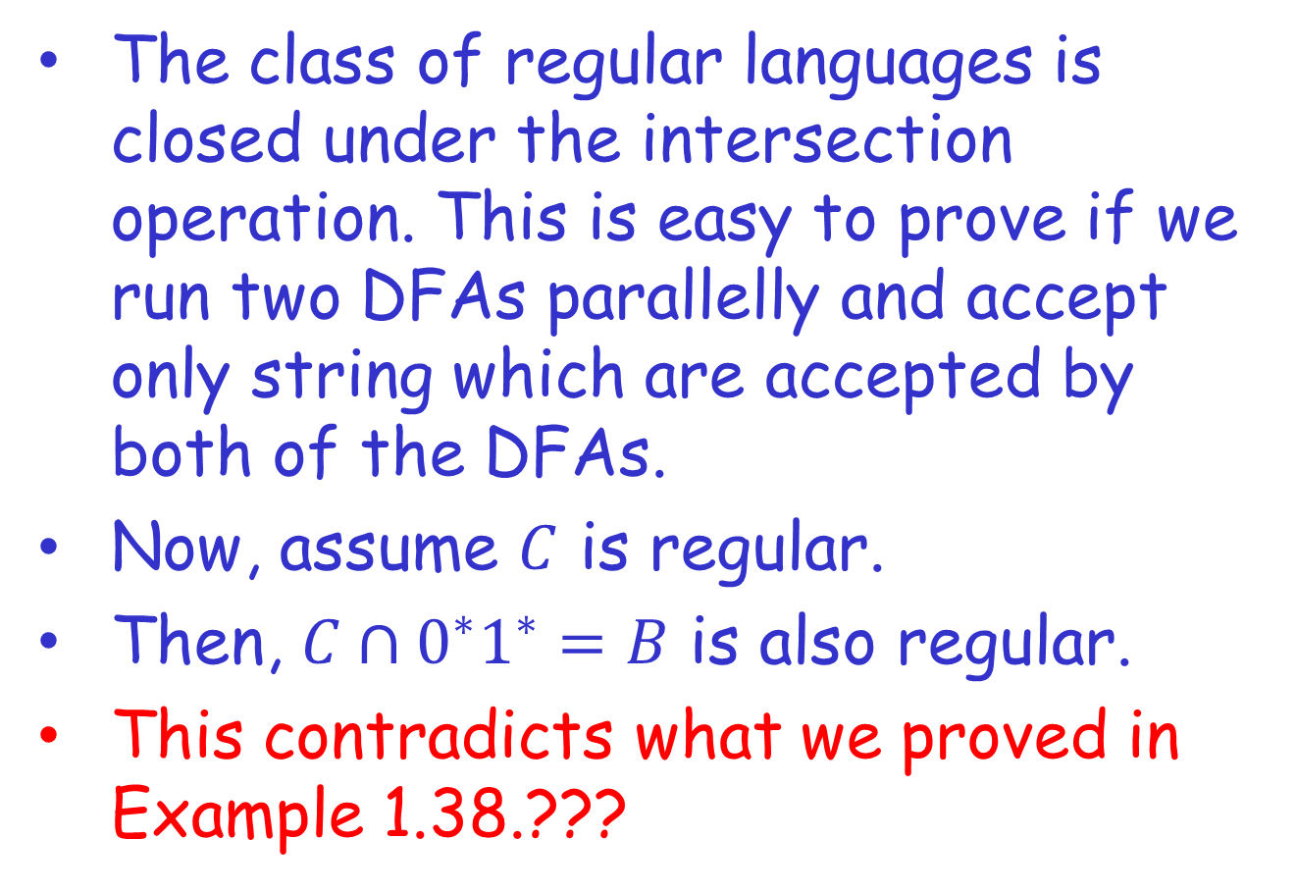
Alternative proof of Example 3
The class of regular languages is closed under the intersection operation. This is easy to prove if we run two DFAs parallelly and accept only string which are accepted by both of the DFAs.
Now, assume $C$ is regular.
Then, $C∩0^{∗}1^{∗}=B$ is also regular.
This contradicts what we proved in Example 1.38.???

Slide 84
Example 4

Slide 85
Example 5

Slide 86
Example 6 (Pumping Down)

Slide 87
Example 6 (Differential Encoding)
0
1
1
0xx0
0xx1
0
0
q_{start}
0
1
1xx1
1xx0
1
1
0

